Slide 1
Presentation of Designing and Implementing a data warehouse OF VAERS
Name:xxx ID:xxx

Slide 2
Data Warehouse Introduction
Dataset
Design the Data Warehouse
ETL Processing
OLAP Analysis
Summary
Notes:
大纲内容介绍：一句话把总体内容介绍一下

Slide 3
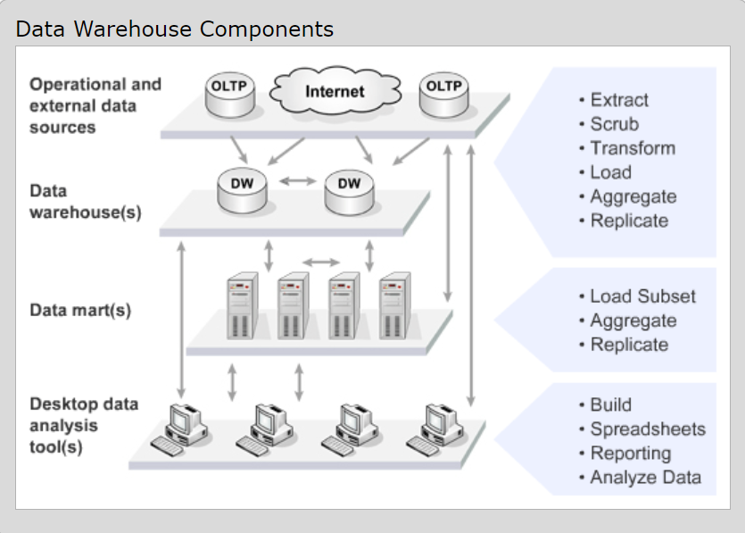
Data Warehouse Introduction
An integrated, subject-oriented, time-variant, nonvolatile database that provides support for decision making.
Notes:
数据仓库概念介绍： 讲一下概念和这个图，这个图上的内容从上到下分别经过的步骤。下一张PPT概括数据仓库主要完成的内容，从Data source 获取数据，
ETL 然后OLAP分析。
1-4 ppt 2min

Slide 4
Data Warehouse Introduction
Data Source
ETL
Analysis

Slide 5
Dataset
VAERS Data Sets （Vaccine Adverse Event Reporting System）is is directly downloaded from https://www.kaggle.com/elenaeb/2021-vaers-vaccination-symptoms-adverse-data
Notes:
介绍一下数据集的来源一句话，说明一下这个数据集的背景，结合report的内容
5-6 用时 3min
The Vaccine Adverse Event Reporting System (VAERS) was created by the Food and Drug Administration (FDA) and Centers for Disease Control and Prevention (CDC) to receive reports about adverse events that may be associated with vaccines… 这段话可以直接读

Slide 6
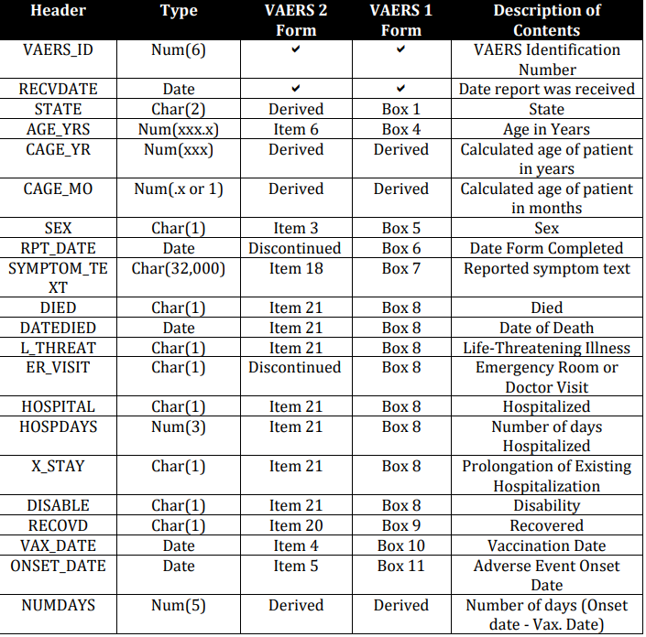
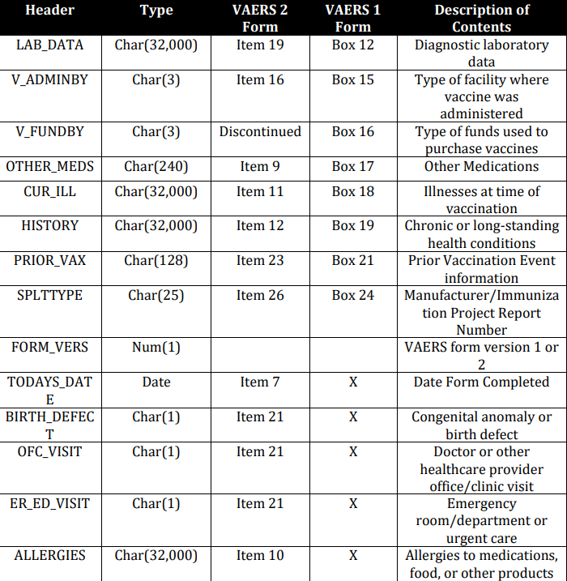
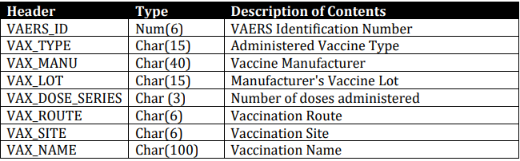
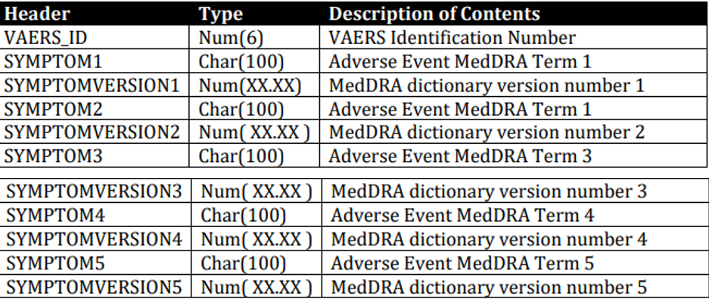
Dataset

Slide 7
Design the Data Warehouse
Some business questions to analyze
Design ERD of the data warehouse
Notes:
从这里开始是数据仓库设计的介绍
根据数据集的内容设计将要解决的商业问题
把每个问题阐述一下
根据问题讲一下设计ERD的思路，需要设计什么Dimensions 和Fact measures.
用时 4 min

Slide 8
Design the Data Warehouse Some business questions to analyze
Some business questions to analyze
（1） What are the symptoms at different ages after getting the COVID-19 vaccine? Which symptoms are the most?
（2）Looking at the vaccines developed by different companies for COVID-19, which company developed the vaccines that produced the most adverse reactions? Which company's vaccine produced the fewest adverse reactions?

Slide 9
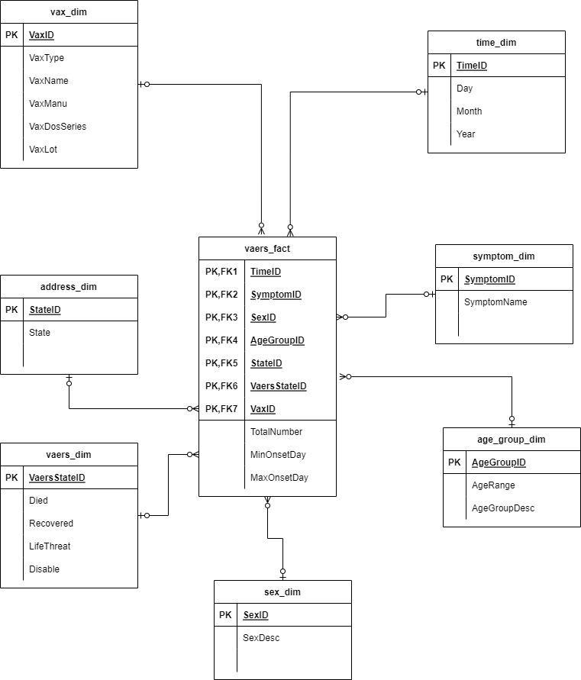
Design the Data Warehouse Design ERD of the data warehouse
Dimensions
Time dimension
Vax dimension
Symptom dimension
Age group dimension
Sex dimension
Address dimension
Vaers dimension

Slide 10
Design the Data Warehouse Design ERD of the data warehouse
Fact Measures
Total number
Max onset day
Min onset day

Slide 11
ETL Processing
Extraction
Transformation
Loading
Notes:
ETL 结合report， 先根据这三个单词讲每个过程需要做什么
然后翻后页ppt 着重讲T， T里面着重讲数据清洗，我们用到python和sql进行数据清洗
这个大章节用时 10min

Slide 12
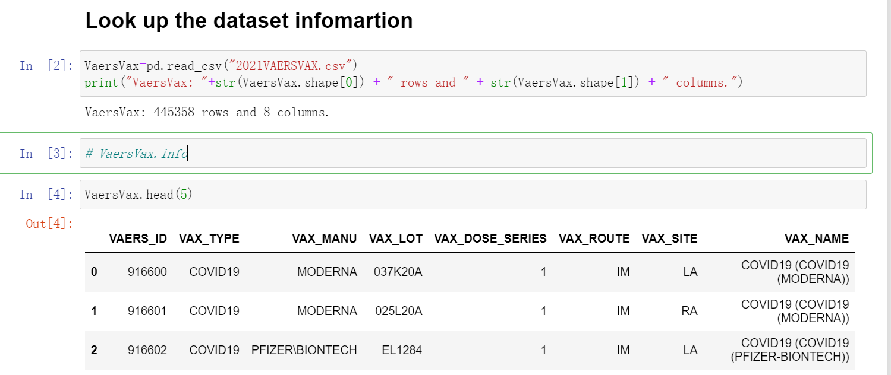
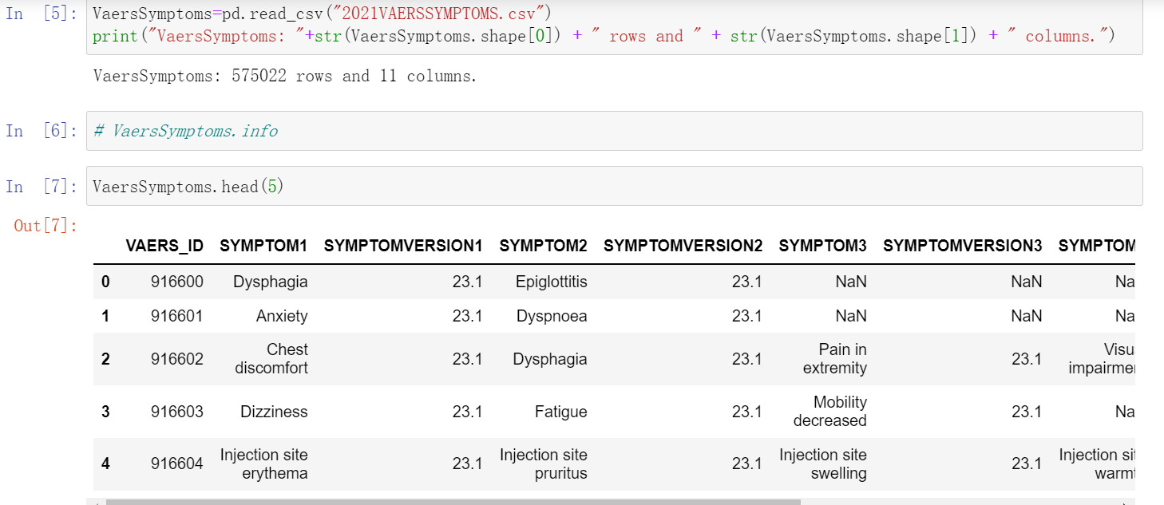
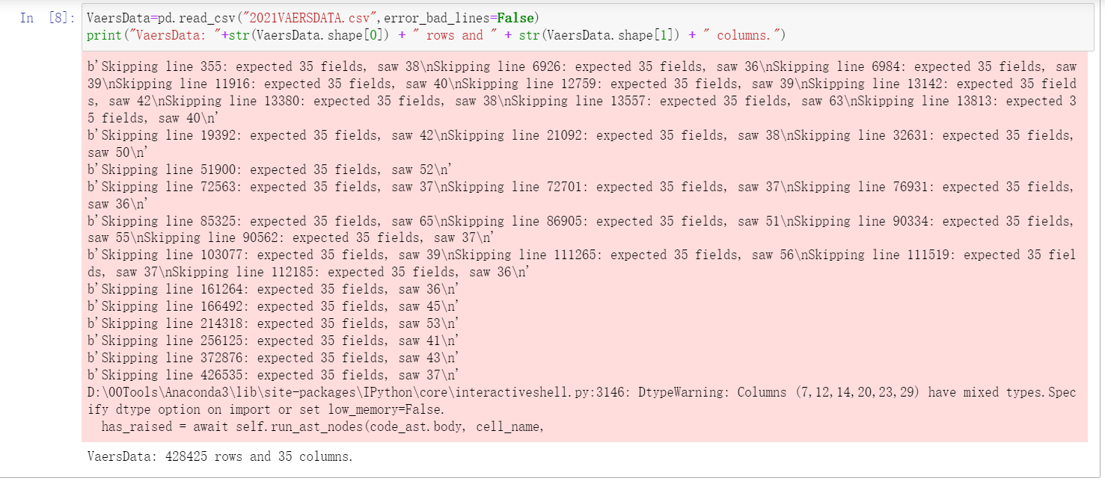
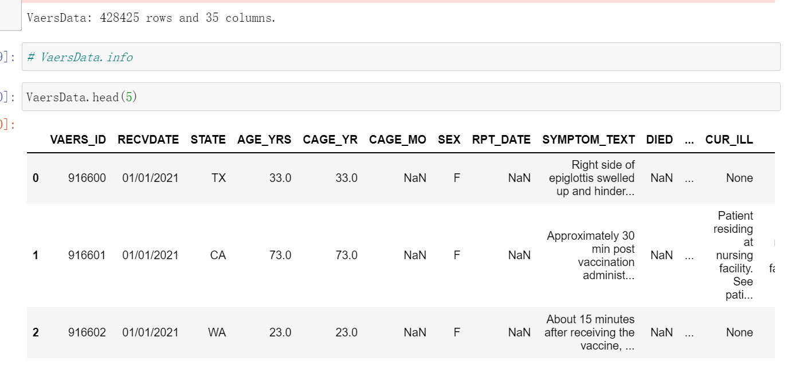
ETL Processing
Extraction
Use Python lib—pandas
Read csv file into pandas DataFrame

Slide 13
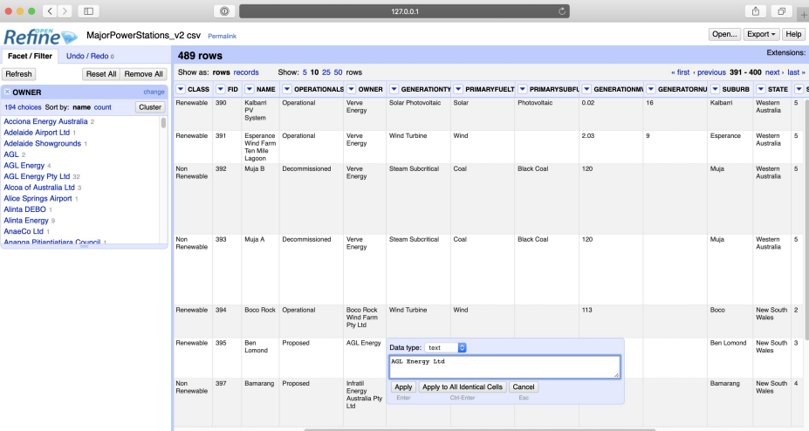
ETL Processing
Transformation
Data Cleansing
ETL tools - OpenRefine

Slide 14
ETL Processing
Transformation
Data Cleansing
Use Python lib- pandas, and SQL
(1) removing duplicated records, all columns that are null values
(2) filtering of missing or inconsistent data
(3) unifying semantic data representations
(4) matching of entries from different sources.

Slide 15
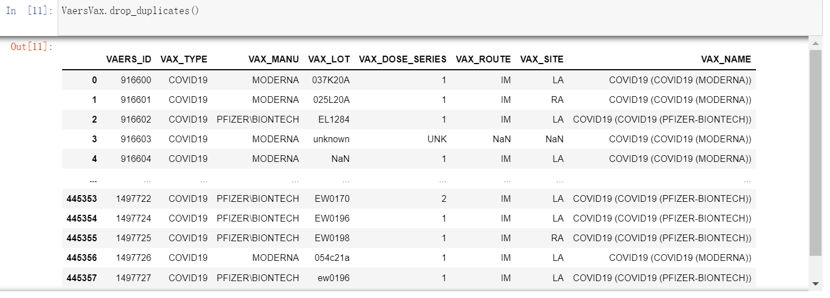
ETL Processing
Transformation
Some examples of my data cleansing
Remove duplicates records of the dataset: one example

Slide 16
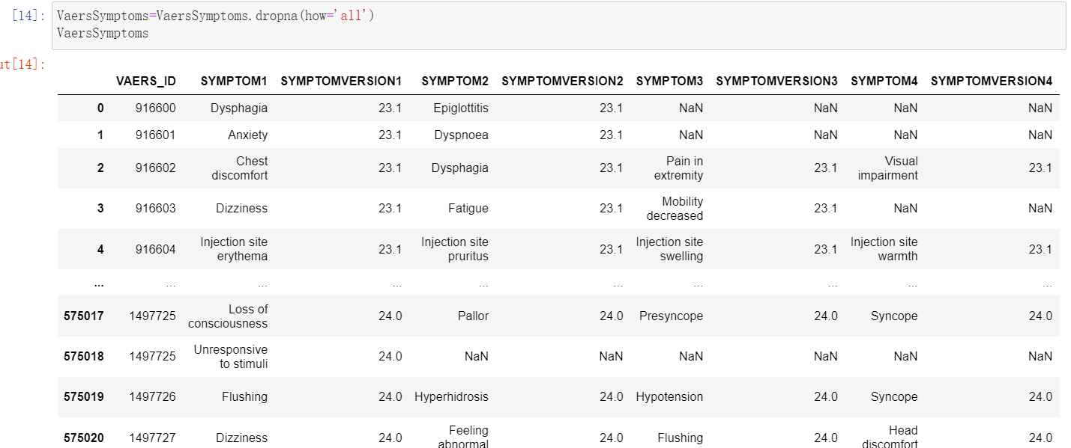
ETL Processing
Transformation
Some examples of my data cleansing
Checking whether all columns of dataset are null values that shouldn't be null

Slide 17
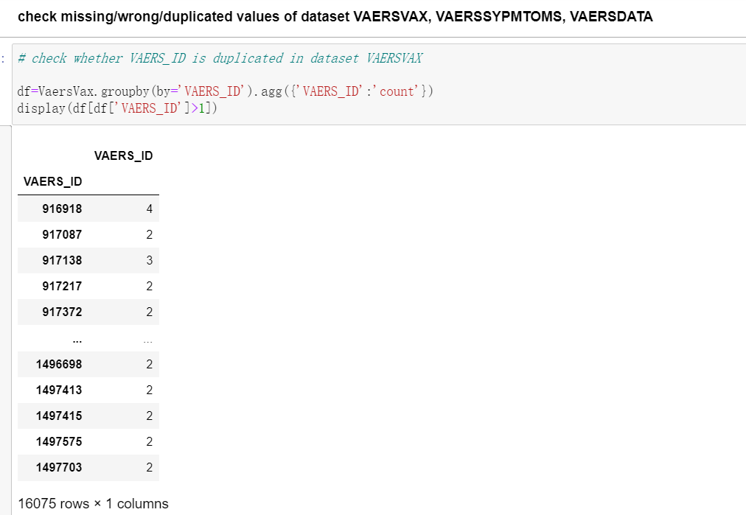
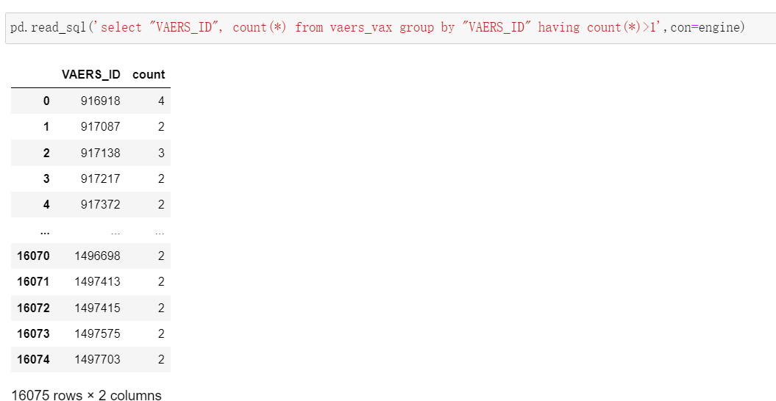
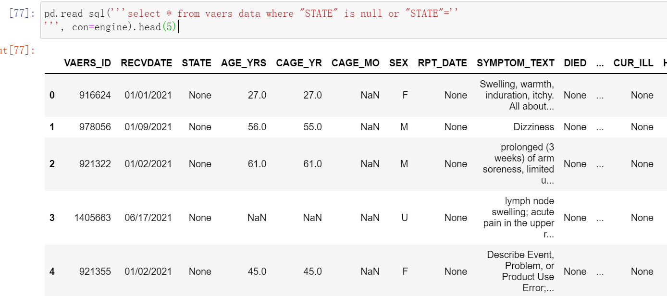
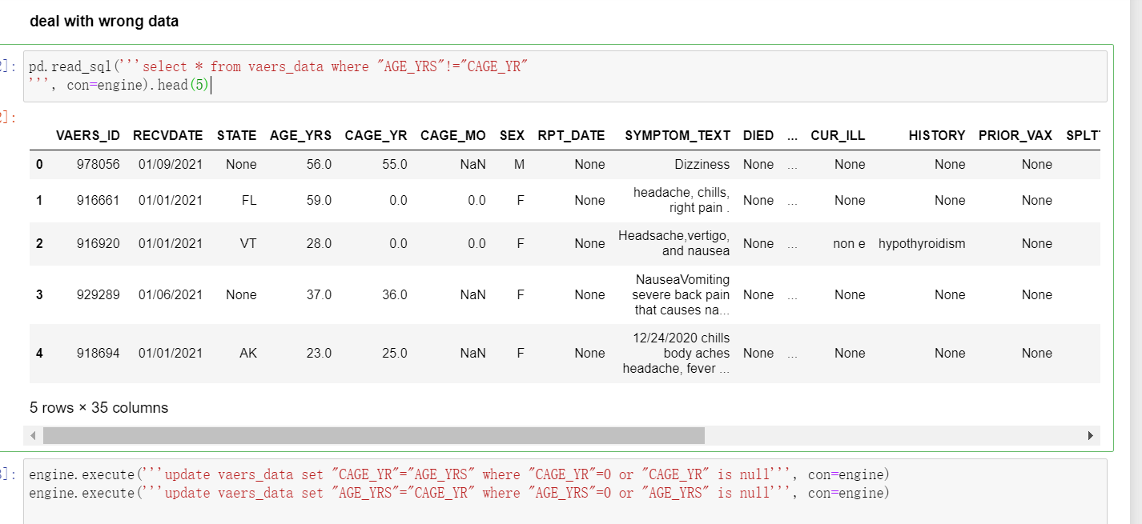
ETL Processing
Transformation
Some examples of my data cleansing-- filtering of missing or inconsistent data

Slide 18
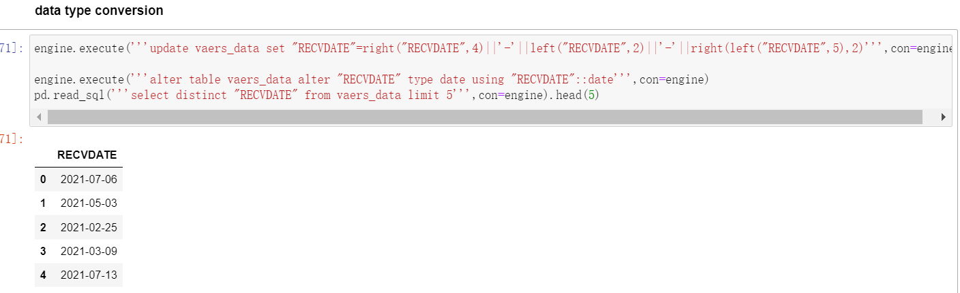
ETL Processing
Transformation
Some examples of my data cleansing
RECVDATE, VAX_DATE, ONSET_DATE need to be converted to Date type.

Slide 19
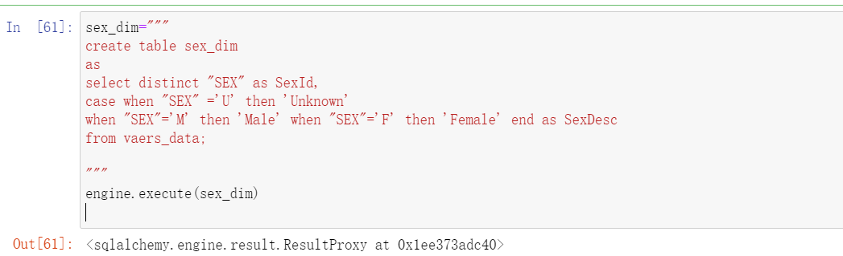
ETL Processing
Loading- sex dimenison

Slide 20
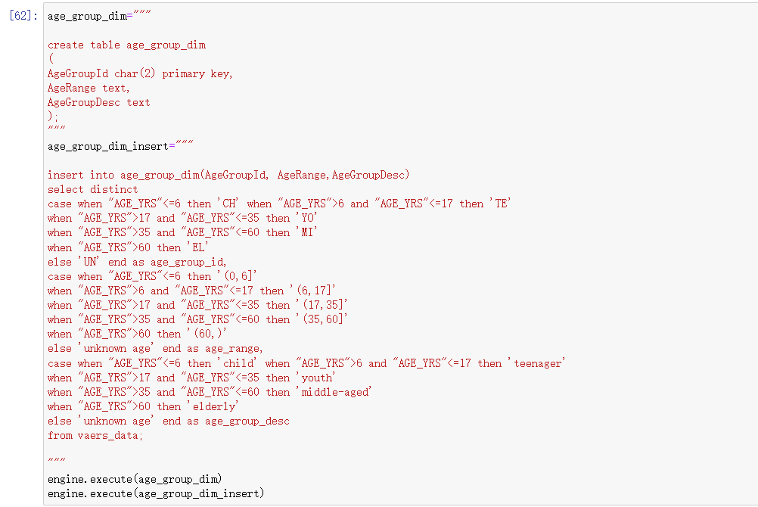
ETL Processing
Loading– age group dimension

Slide 21
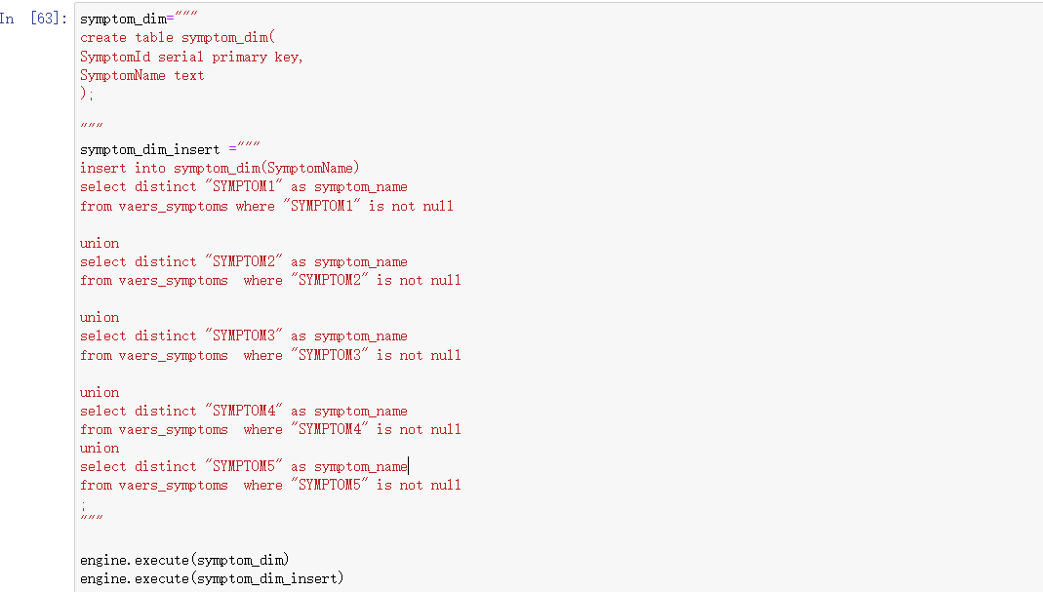
ETL Processing
Loading– symptom dimension

Slide 22
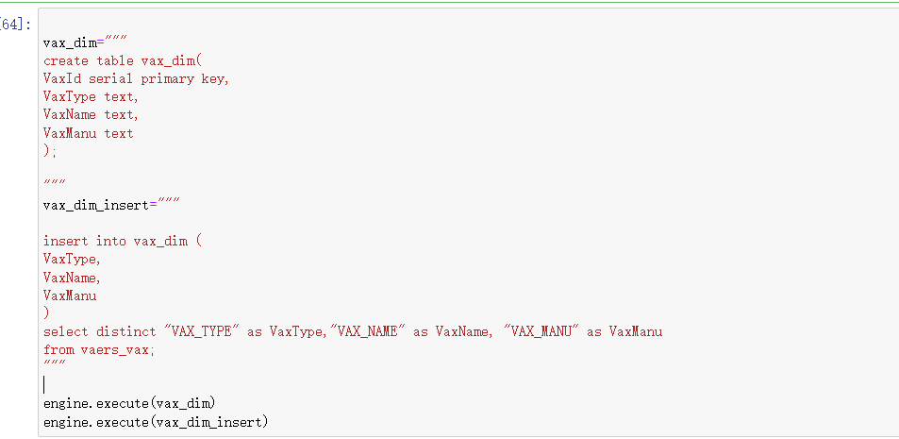
ETL Processing
Loading--vax dimension

Slide 23
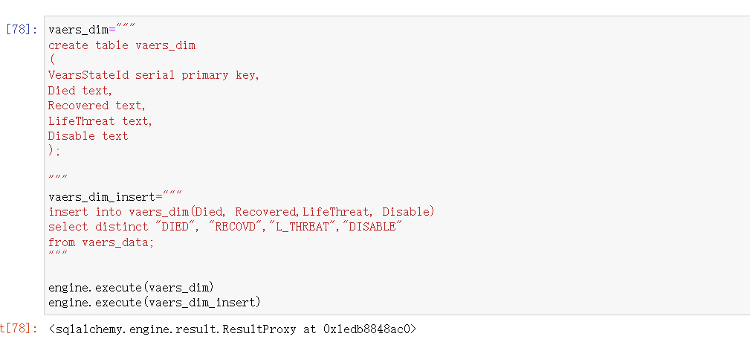
ETL Processing
Loading– vaers dimension

Slide 24
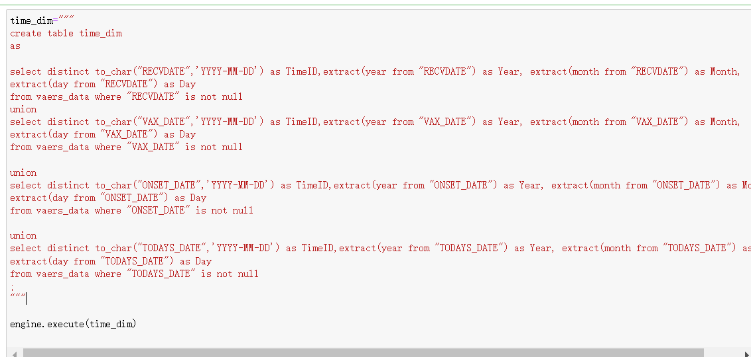
ETL Processing
Loading– time dimension

Slide 25
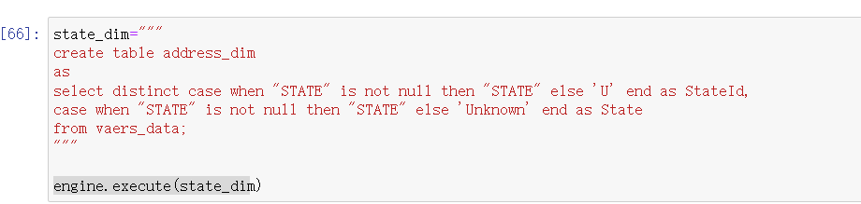
ETL Processing
Loading– address dimension

Slide 26
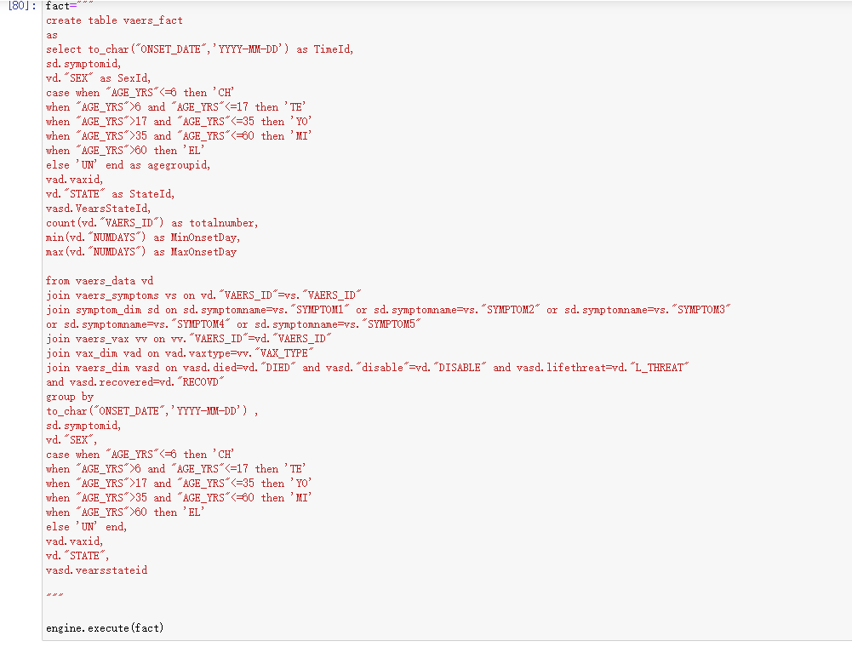
ETL Processing
Loading– vaers fact table

Slide 27
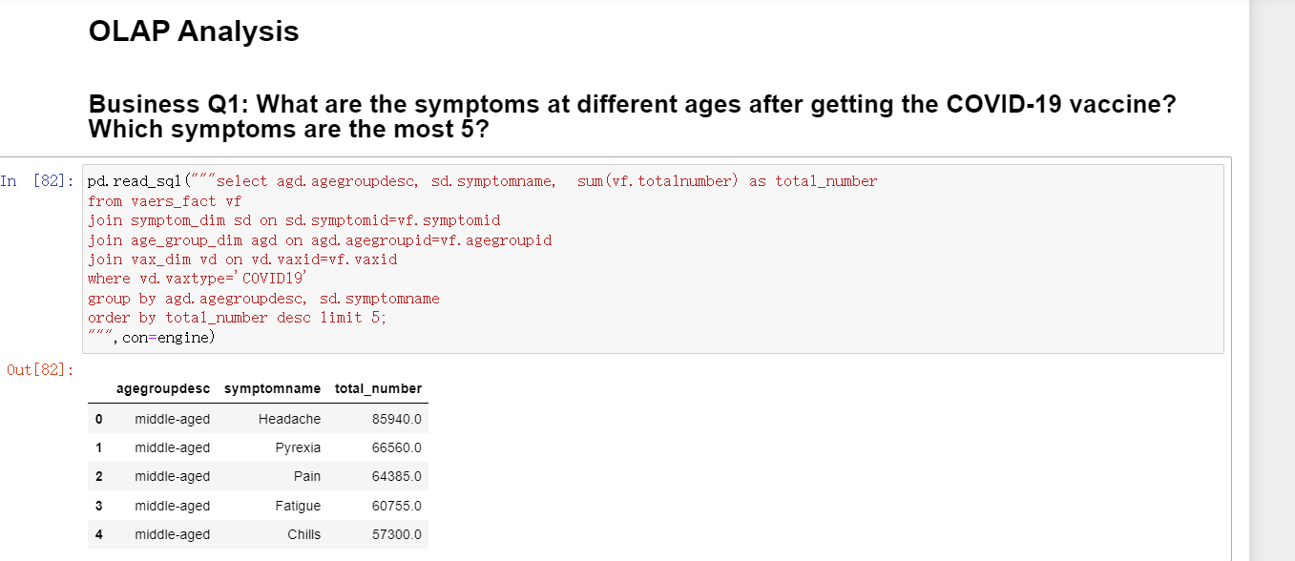
OLAP Analysis
Notes:
OLAP 分析， 讲解决前面提出的business questions.
2min

Slide 28
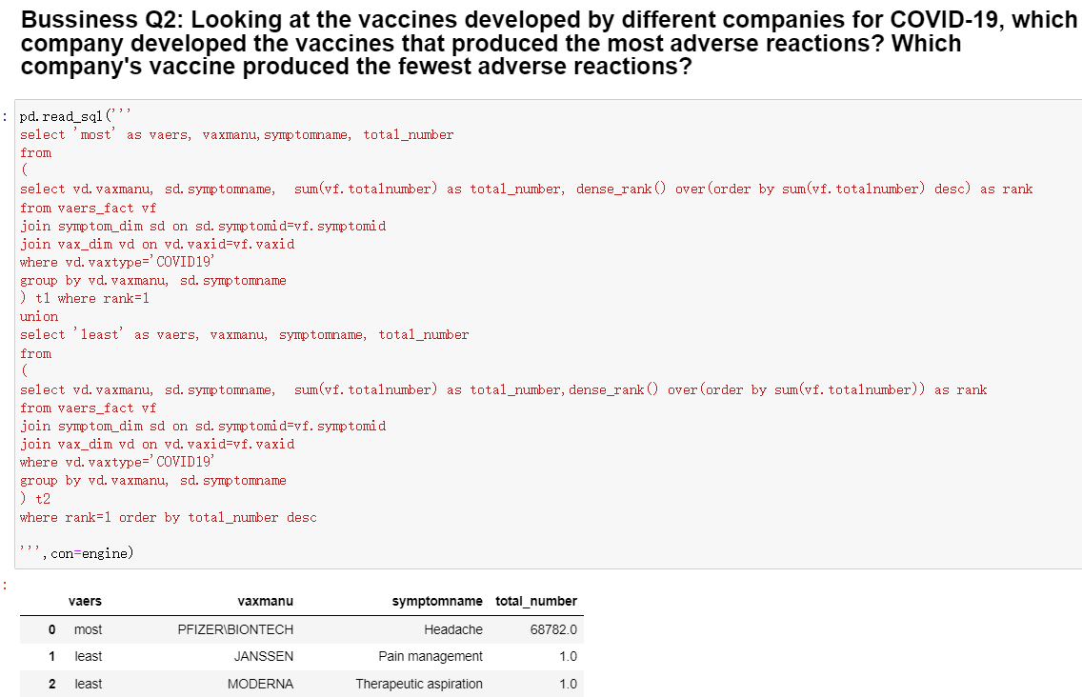
OLAP Analysis
Notes:
OLAP 分析， 讲解决前面提出的business questions.
2min

Slide 29
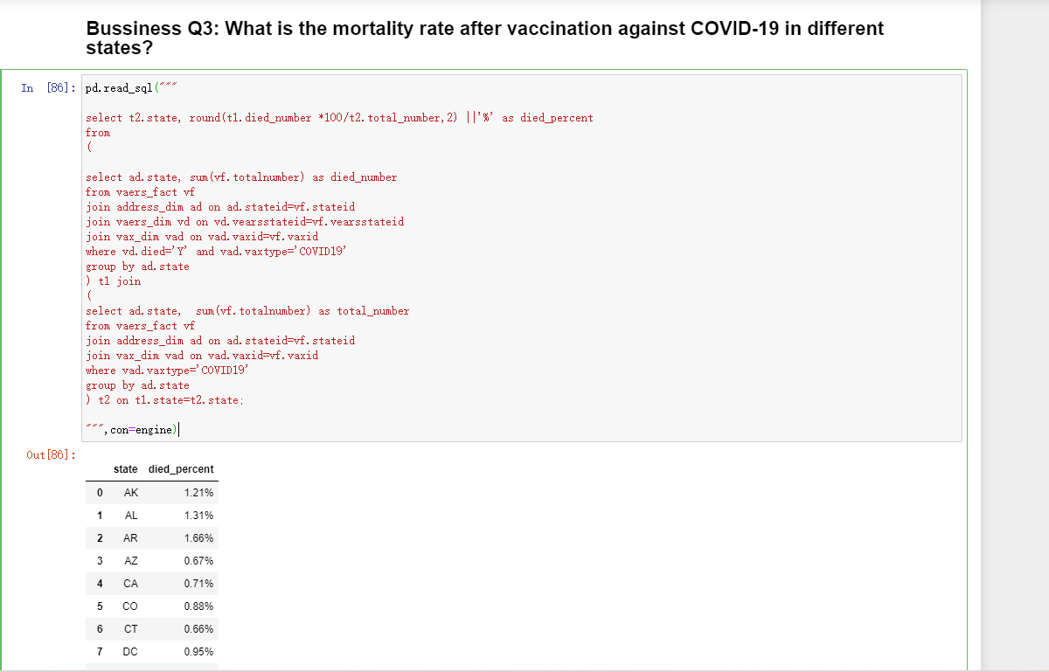
OLAP Analysis
Notes:
OLAP 分析， 讲解决前面提出的business questions.
2min

Slide 30
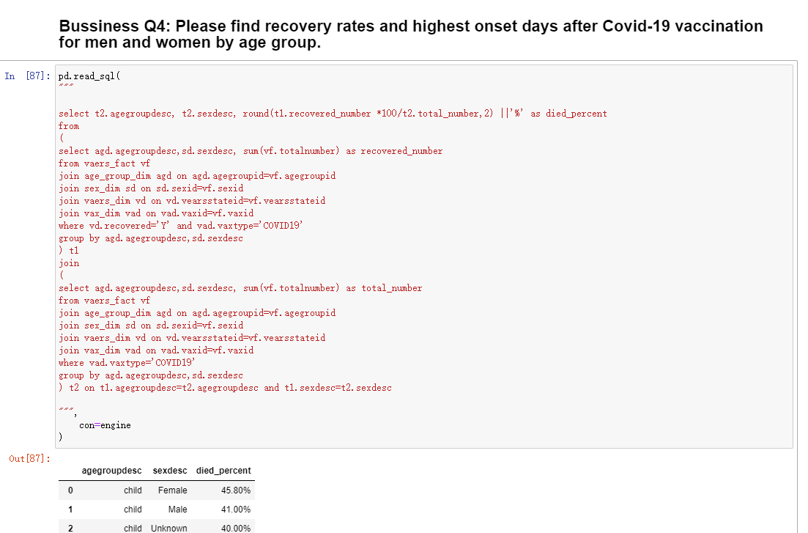
OLAP Analysis
Notes:
OLAP 分析， 讲解决前面提出的business questions.
2min

Slide 31
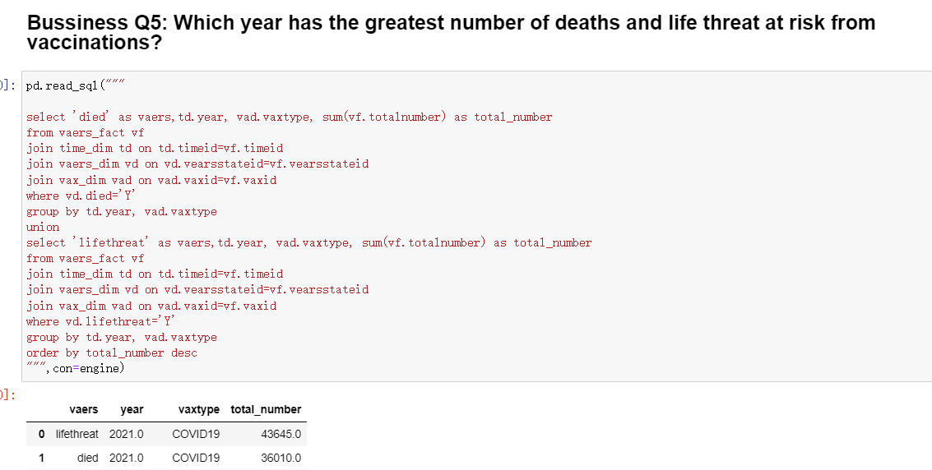
OLAP Analysis
Notes:
OLAP 分析， 讲解决前面提出的business questions.
2min

Slide 32
SuMMARY
What I have lean
Some challenge
Problems when I finish my final project
Notes:
总结，学到的东西和挑战 以及遇到的问题
这个就基本上讲report
3min

Slide 33
SuMMARY
What I have lean
Design data warehouse
ETL processing
OLAP analysis to answer business problems

Slide 34
SuMMARY
Some challenge
Design data warehouse– how to choose dimensions, how to design fact measures
ETL processing— extraction and transformation are very key steps, data cleansing need a lot of time
OLAP analysis to answer business problems— sql technology

Slide 35
SuMMARY
Problems when I finish my final project
Extraction: UnicodeDecodeError
Extraction: ParseError of dataset, It has inconsistent number of columns of my dataset.
Dataset is huge: query is a little bit slow. Here I add some useful indexes to try to make it faster.

